Slide 1


TEAM-019
WE BYTE

Slide 2
ExternShip ProJect
Power Consumption Analysis For HouseHolds
TEAM -007
PRESENTED BY:
Shaik Abbas(18UK1A0550)
Kaleru Naresh ( 18UK1A0538)
Ganta Suchendarreddy (18UK1A0516)
Bhukya Santhosh (18UK1A0507)
PRESENTED TO:
Pradeepthi Raju(Mentor).

Slide 3
Table of Contents
Introduction
ABSTRACT
SOFTWARE DESIGNING
DATASET DESCRIPTION

Slide 4
INTRODUCTION:
Electricity load forecasting has gained substantial importance nowadays in the modern electrical power management systems with elements of smart greed technology.
At the level of individual households, the ability to accurately predict consumption of electricity power significantly reduces prices by appropriate systems for energy storage.
Therefore, the energy efficient power networks of the future will require entirely new ways of forecasting demand on the scale of individual households.
The analysis of a time series used forecasting techniques to identify models from the past data. With the assumption that the information will resemble itself in the future, we can thus forecast future events from the occurred data.

Slide 5
ABSTRACT:
ABSTRACT:
The project entitled 'Power Consumption Analysis of Household’, In this, we analyse the average usage and emphasis of home appliances based on the characteristics of power data in households. In the case of electric power used in households, the controllability of individual appliances is determined according to the characteristics, and the analysis. Relying on the result of this kind of analysis, it is possible to suggest a more efficient energy operation from the viewpoint of the energy consumer. Therefore, by analysing the characteristics of each power source based on the time horizon, we set the priority of individual power resources according to the user preference. We take the numerical results from the models and gives some recommendations regarding the choice of end-use approach and what concerns to carry out in household surveys designed to disaggregate electricity consumption.

Slide 6
SOFTWARE DESIGNING:
Jupyter Notebook Environment and Google Colab
Spyder Ide
Machine Learning Algorithms
Python (pandas, numpy, matplotlib, seaborn, sklearn)
HTML
Flask

Slide 7
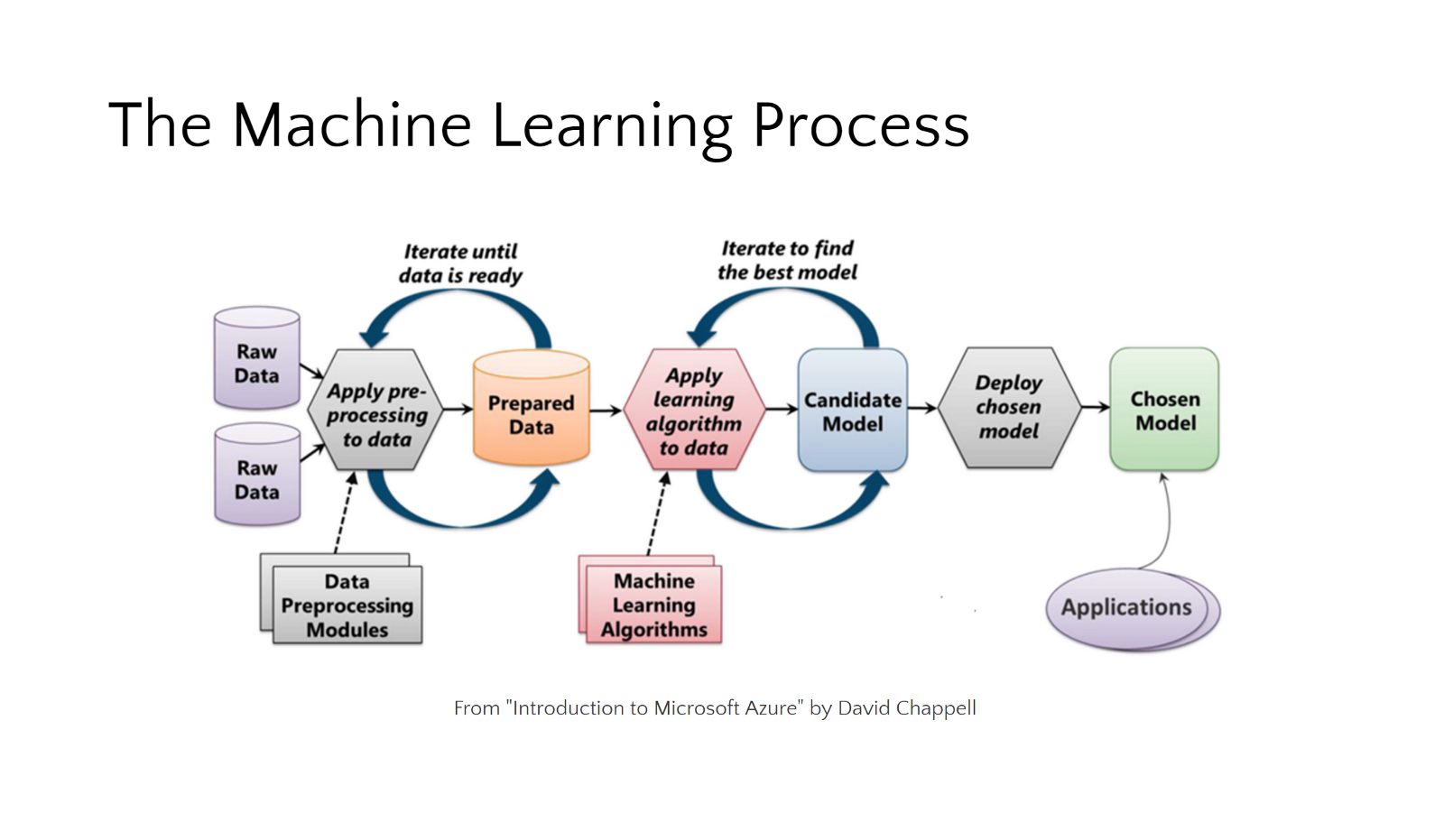

Slide 8
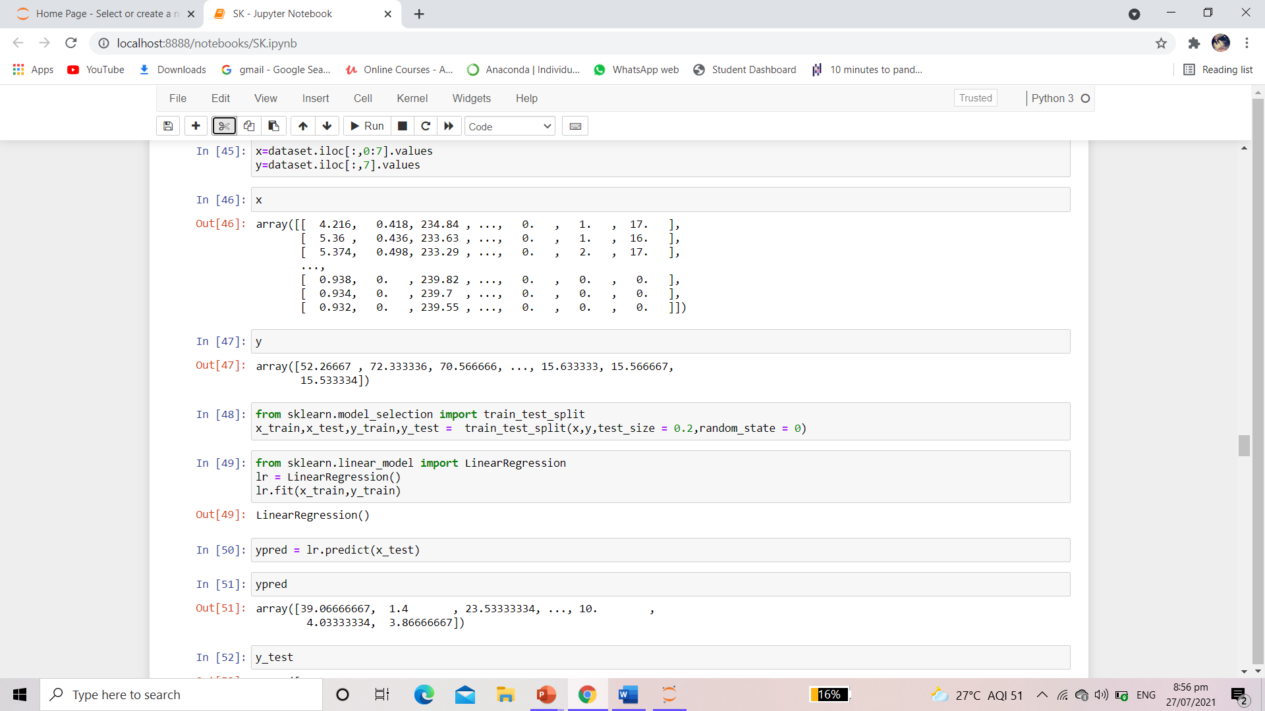

Slide 9
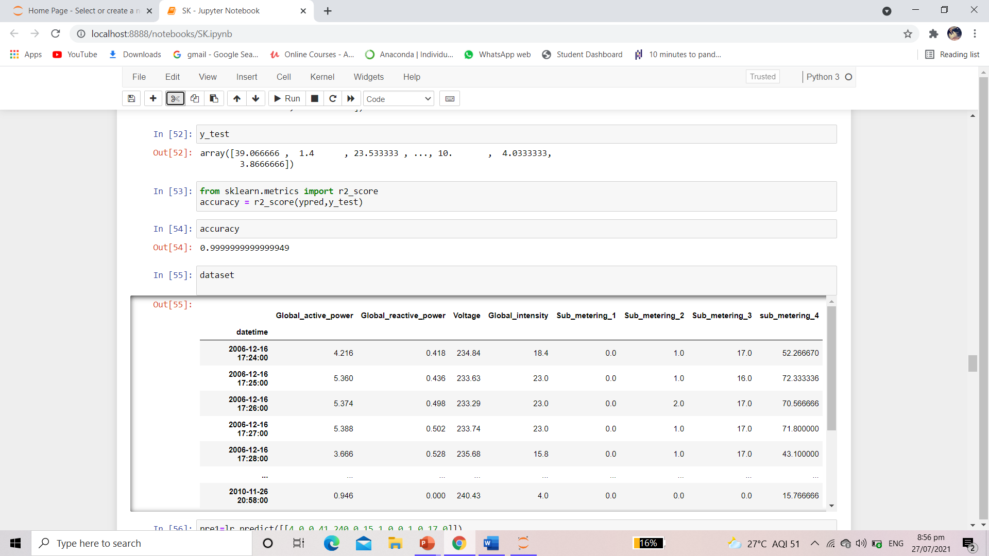

Slide 10
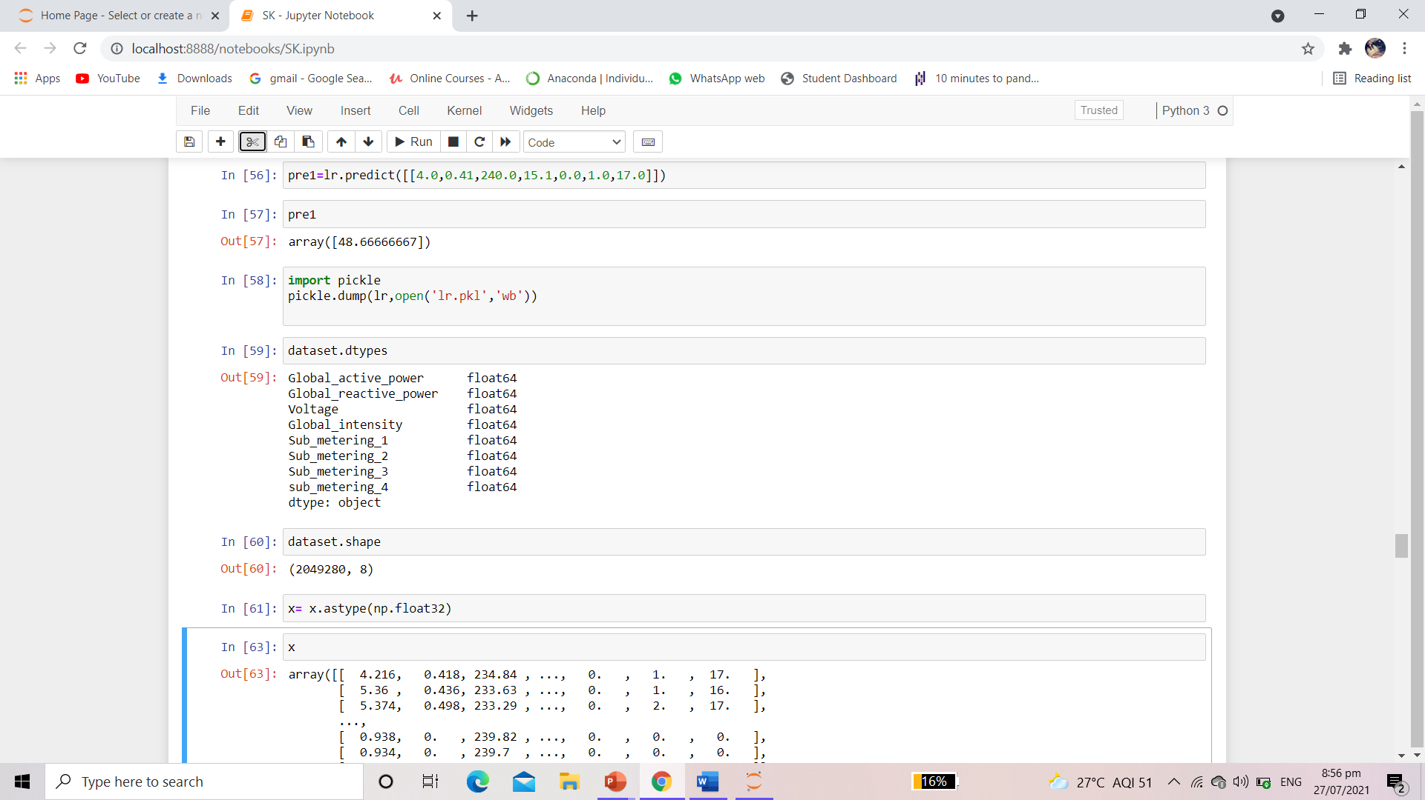

Slide 11
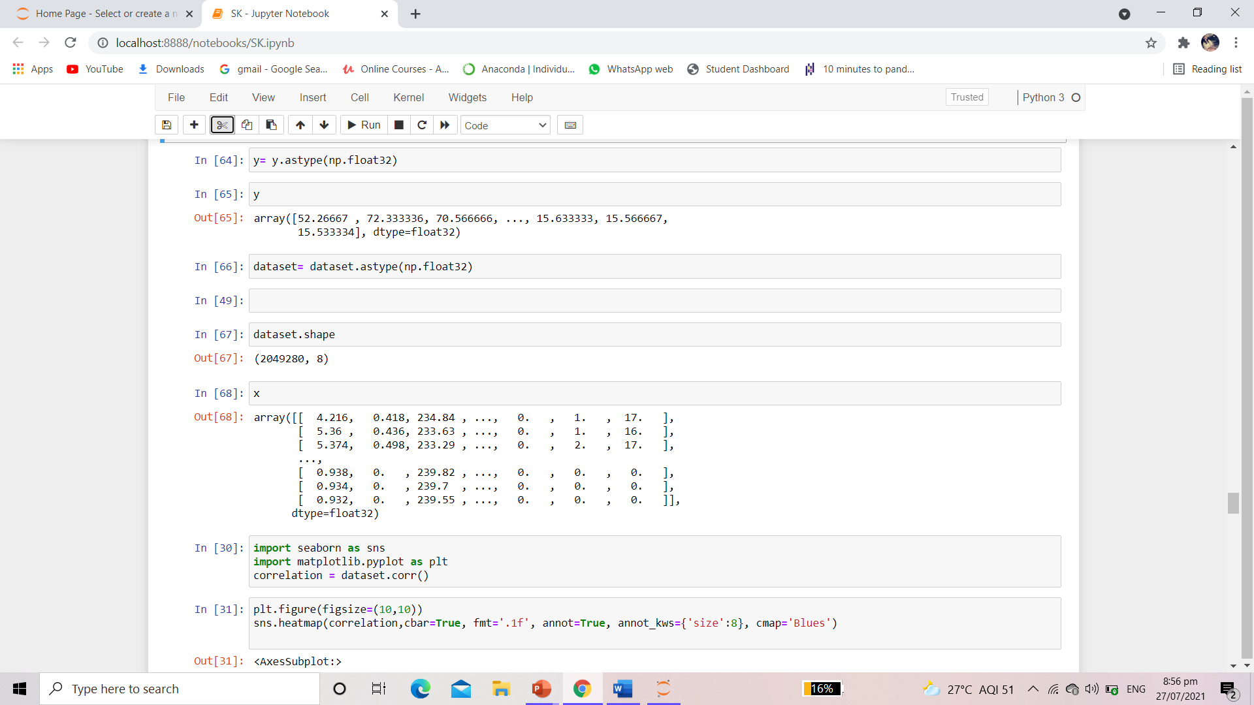

Slide 12
DATASET DESCRIPTION
The Household Power Consumption dataset is a multivariate time series dataset that describes the electricity consumption for a single household over four years.
This archive contains 2075259 measurements gathered in a house located in Sceaux (7km of Paris, France) between December 2006 and November 2010 (47 months).
It is a multivariate series comprised of seven variables (besides the date and time); they are:
• Global_active_power: The total active power consumed by the household (kilowatts).
• Global_reactive_power: The total reactive power consumed by the household (kilowatts).
• Voltage: Average voltage (volts).
• Global_intensity: Average current intensity (amps).
• Sub_metering_1: Active energy for kitchen (watt-hours of active energy).
• Sub_metering_2: Active energy for laundry (watt-hours of active energy).
• Sub_metering_3: Active energy for climate control systems (watt-hours of active energy).

Slide 13
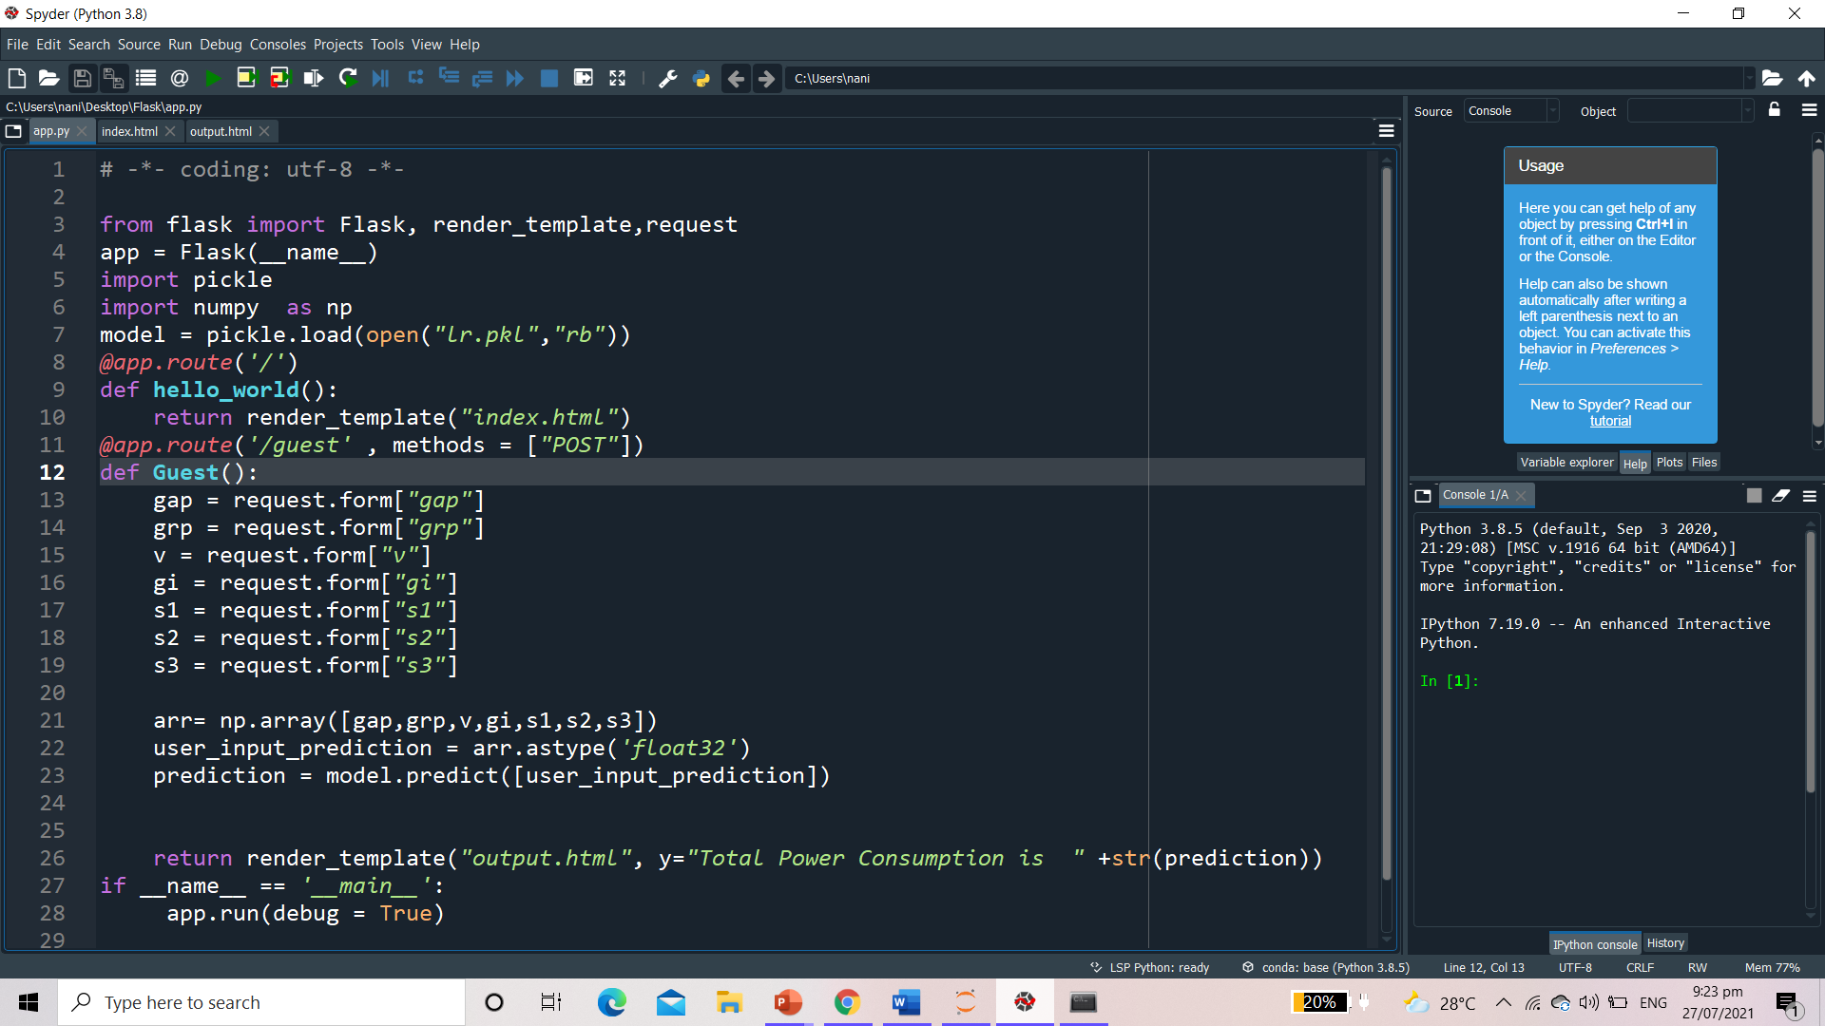

Slide 14
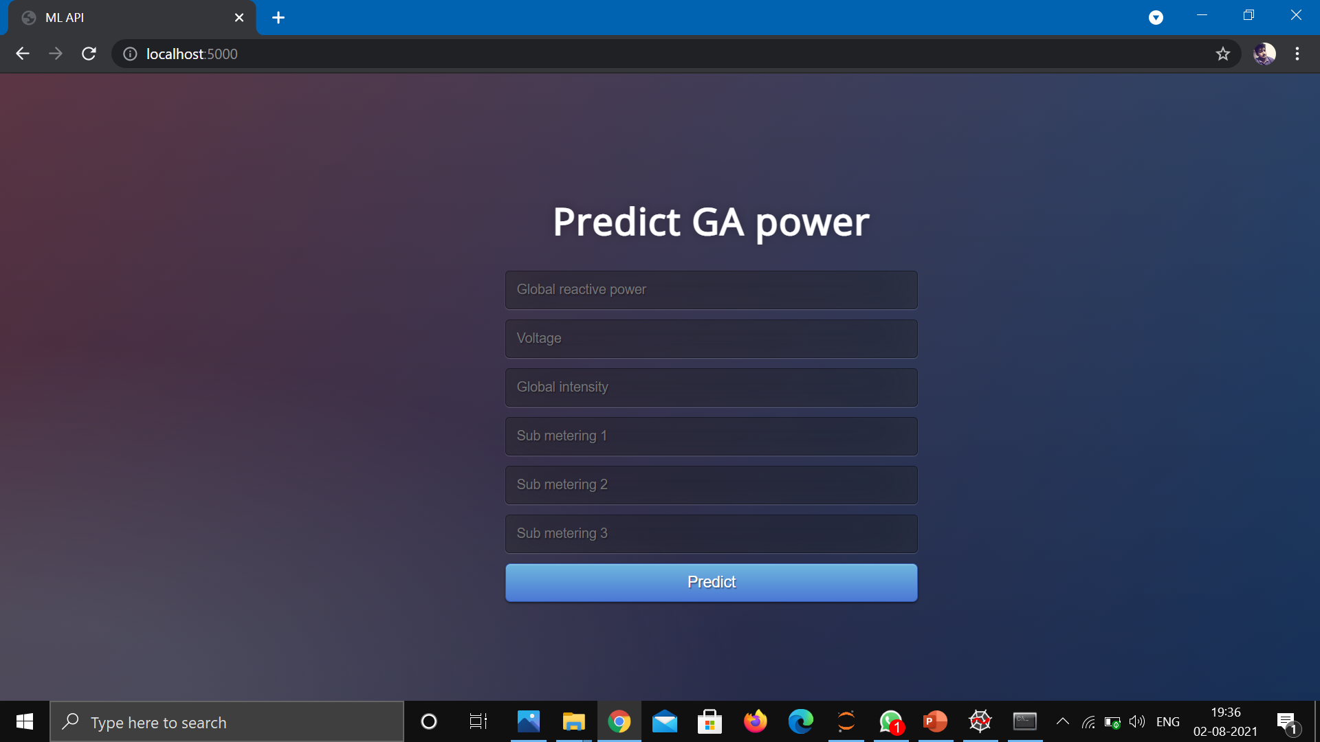

Slide 15
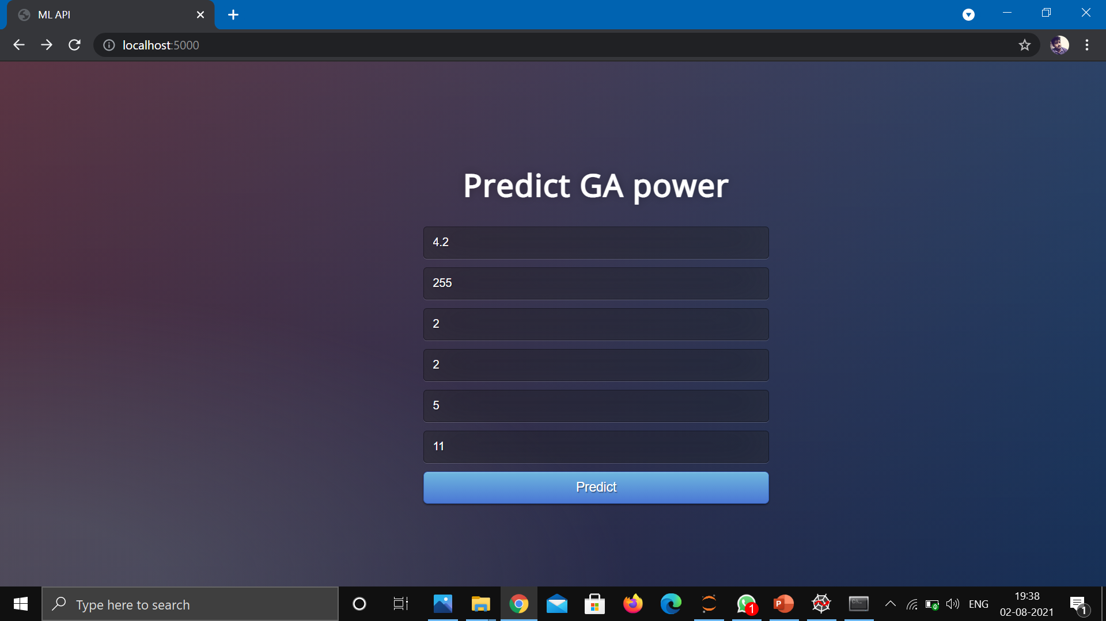

Slide 16
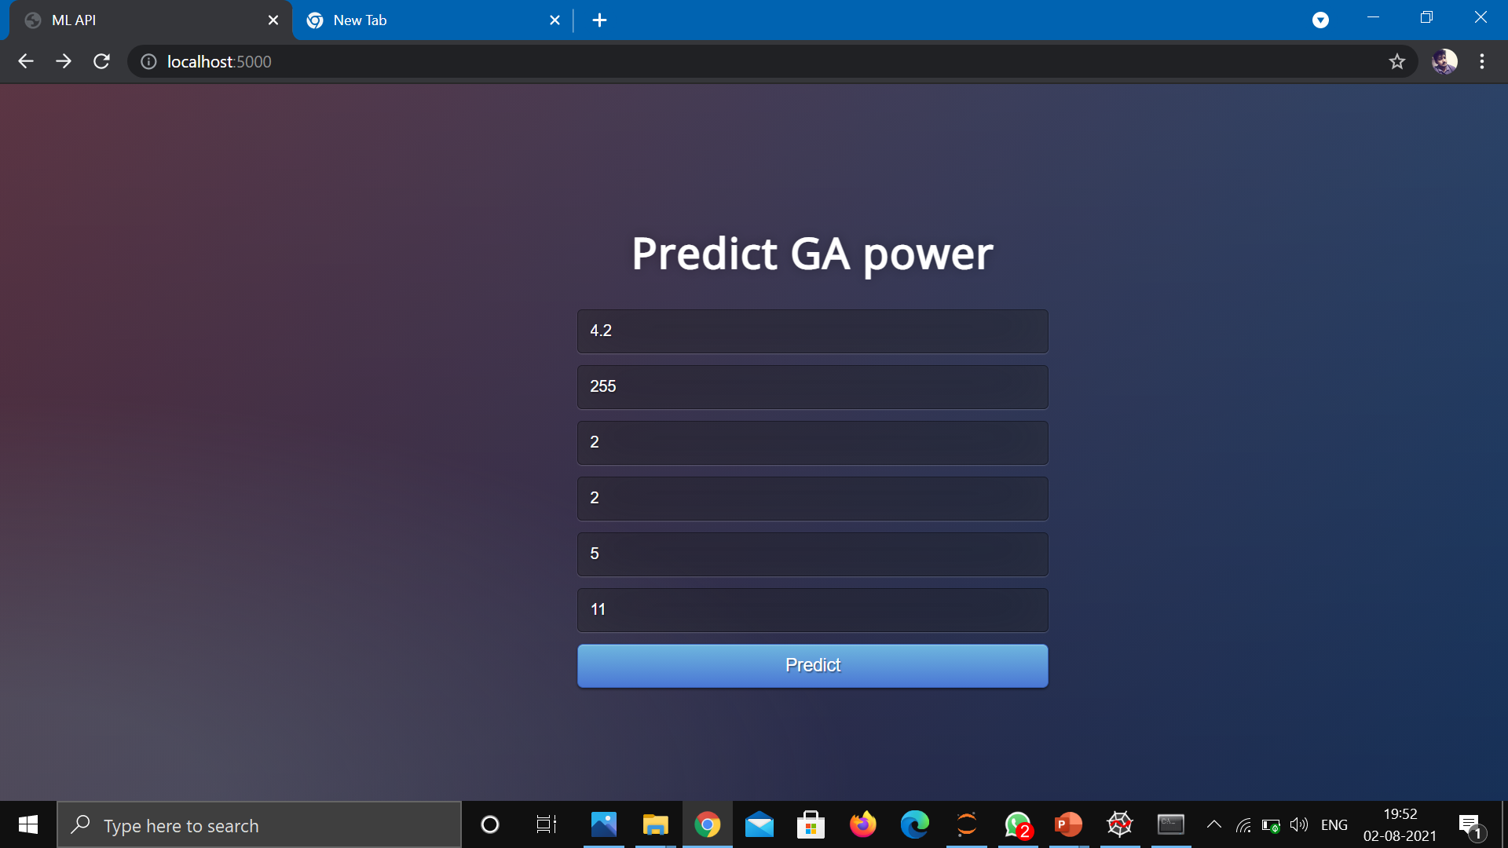
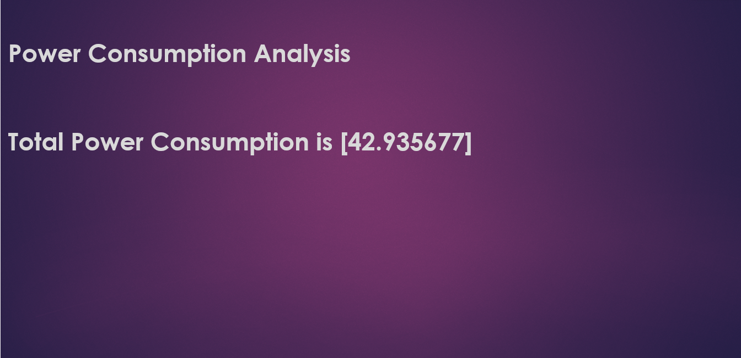

Slide 17
THANK YOU…!

